Slide 1
Mass-suite
Ximin Hu, Derek Mar, Nozomi Suzuki, Bowei Zhang

Slide 2
Introduction
Why Mass-suite
Full stack capability for Non-target HRMS data processing
Python is popular
Open-source
High Resolution Mass Spectrometry (HRMS)
Novel technology for water quality assessment
Data massive for interpretation and detailed analysis
Current software hard to meet every needs
Pollutant in water
Complicated and coming from different sources
Hard to identification and track
Current technologies are more concentrating on one/few chemical

Slide 3










Overview of Mass-suite
data processing
Other tools
Essential functions for HRMS data processing:
Mzml import
Peak picking
Alignment
Data curation
More..
HRMS data processing assisting tools:
Formula annotation
MS2 spectrum online search
HRMS data quality report
More..
visualization
Always new
Various plot tools for visualizing HRMS data:
Chromatograms
Spectrums
Static/Interactive options
More..
Data mining
There are always something new:
Source identification
Source quantitative apportionment
MS2 data mining
Even more..
Explore HRMS data with data science tools:
Principle Component Analysis
T-SNE Dimension reduction
Clustering analysis based on DBSCAN/OPTICS
Various modeling options
More..

Slide 4
Package use example
Briefly show 1~2 screenshot from each subpackages

Slide 5
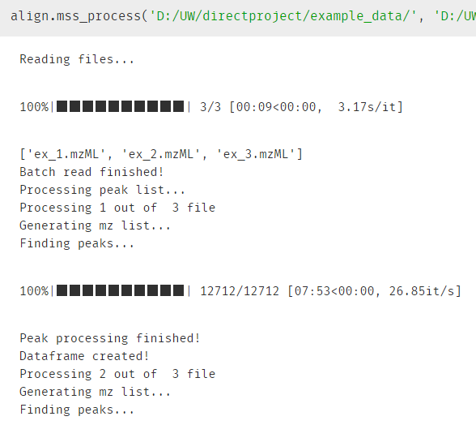
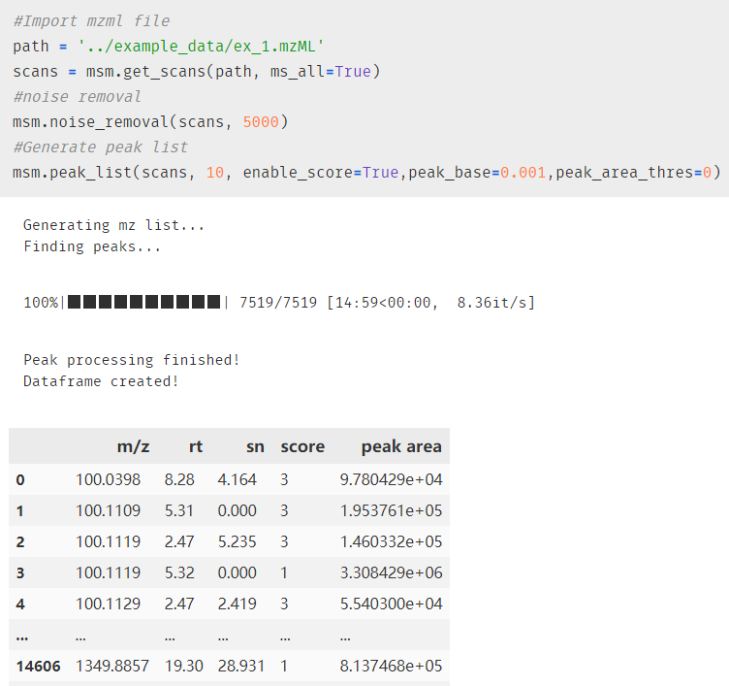
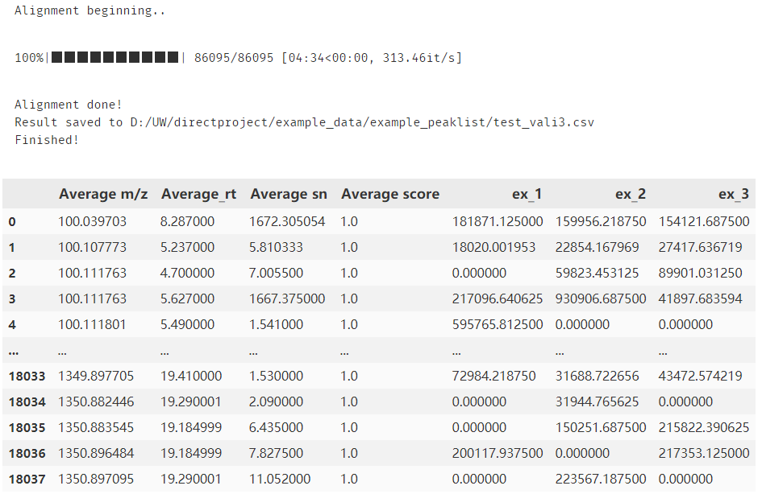
One-line option
Step-by-step option

Slide 6
code

Slide 7
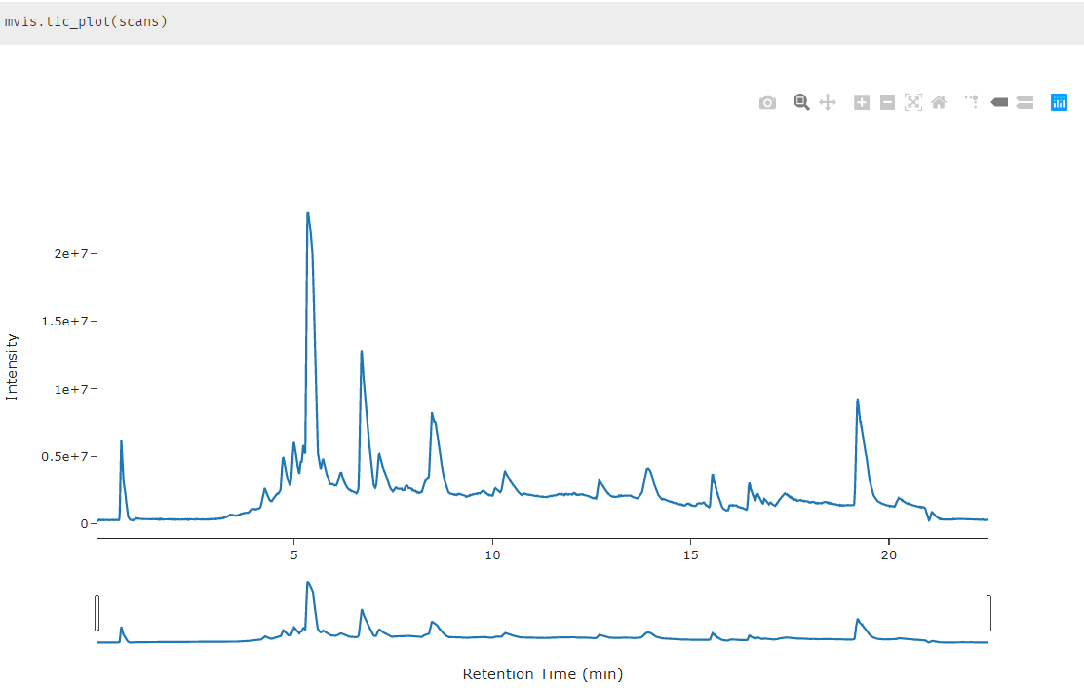

Slide 8
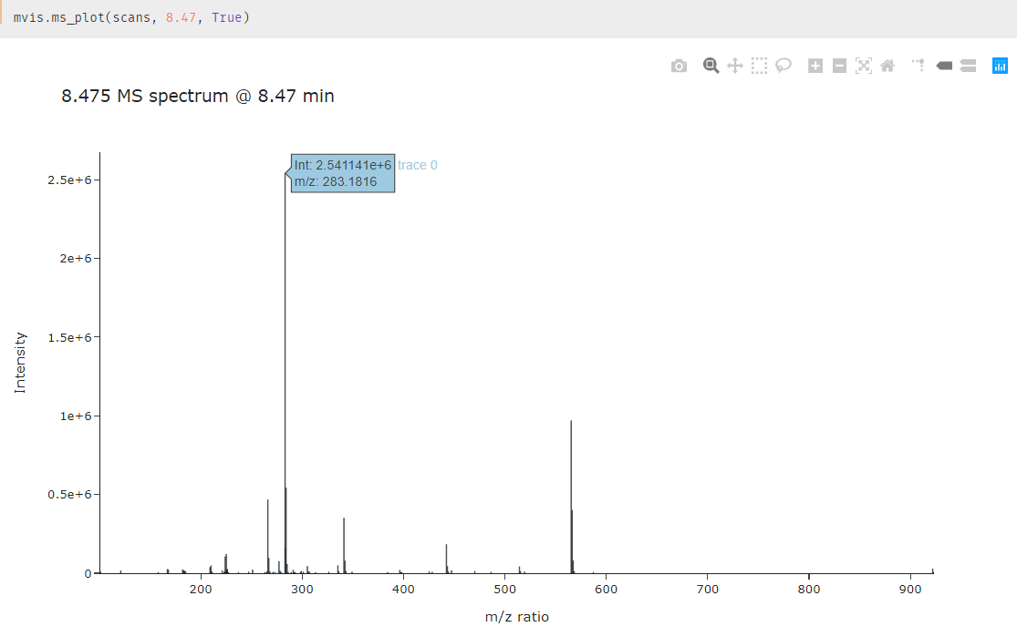

Slide 9
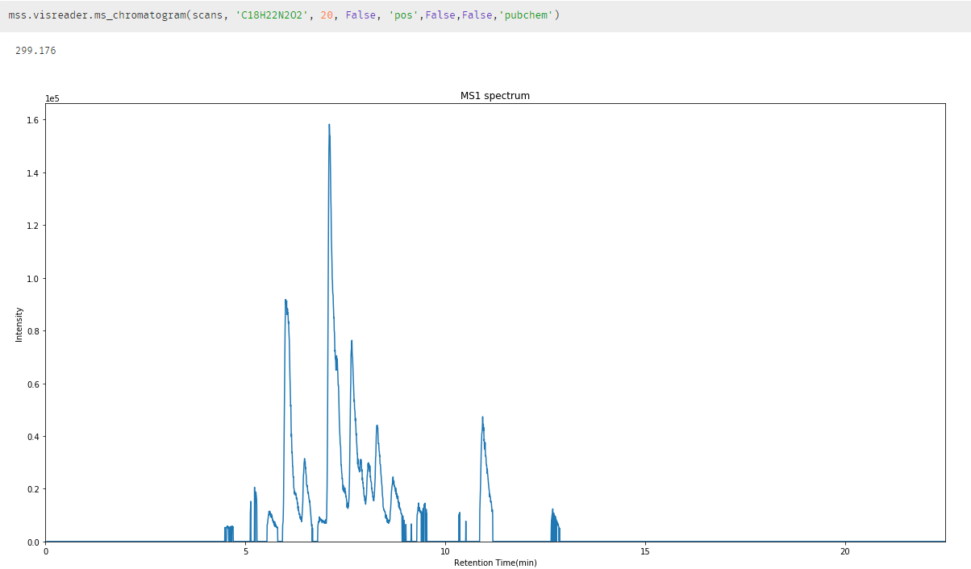

Slide 10
Peak picking & alignment
Quality report
Oneline vs discrete steps
Modeling?
One-line processing
Show benchmark

Slide 11
Data mining
Show dbscan trend plot

Slide 12
Runtime & port benchmark
Runtime benchmark
Hyak capability – citation?

Slide 13
User case
Users: HRMS instrument users
Usage:
Data import
Translation to readable format
Visualization
Find end member
Advanced analysis
Input data:
Converted HRMS data in .mzml format
Outputs:
Data report
Visualization plots
Data analysis results based on user settings

Slide 14
Peak picking &alignment
Mzml file import
Mainly based on pymzml package, which provided a high efficiency access to the raw data even during iterations
Single file/batch files option available
Raw data cleaning
MS1/MS2 scan selection
Noise removal
Peak picking & peak table export
Mainly based on peakUtils package
Utilized random forest model to assess the peaks
Alignment of different data using user settings

Slide 15
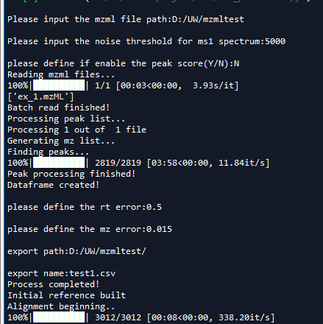
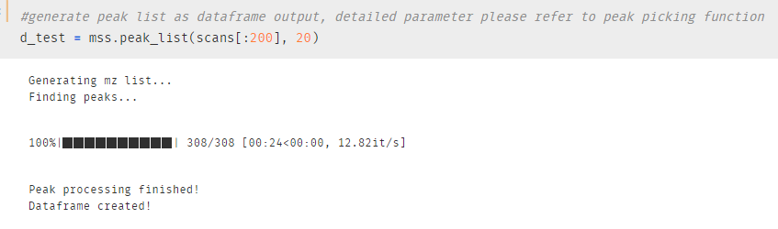
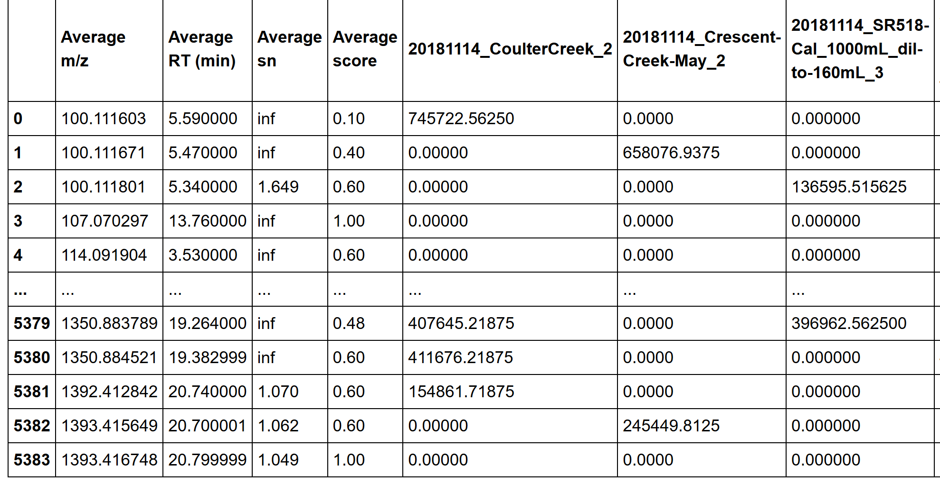
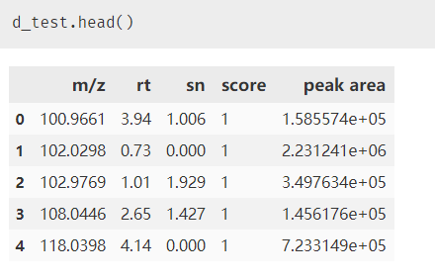
Sample output

Slide 16
Clustering & modeling
Grouping the chemical features using their behavior pattern in different samples:
Example: diluted sample from no dilution to 1000 times dilution
Cluster1: increase
Cluster2: decrease
Cluster3: increase first and then decrease
Based on the cluster information, separately build models for each cluster on selected dataset
Use the overall model to assess the data

Slide 17
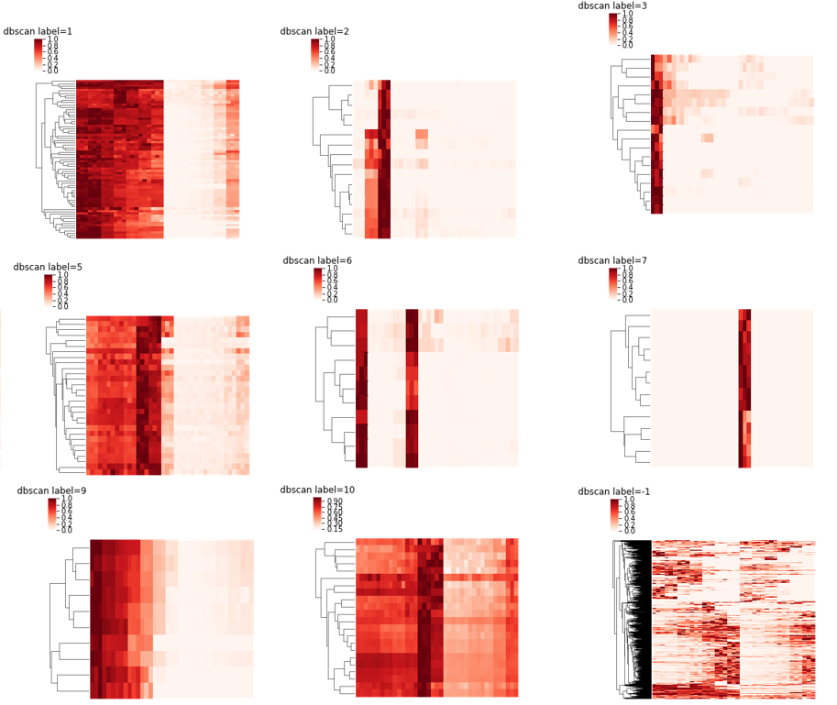
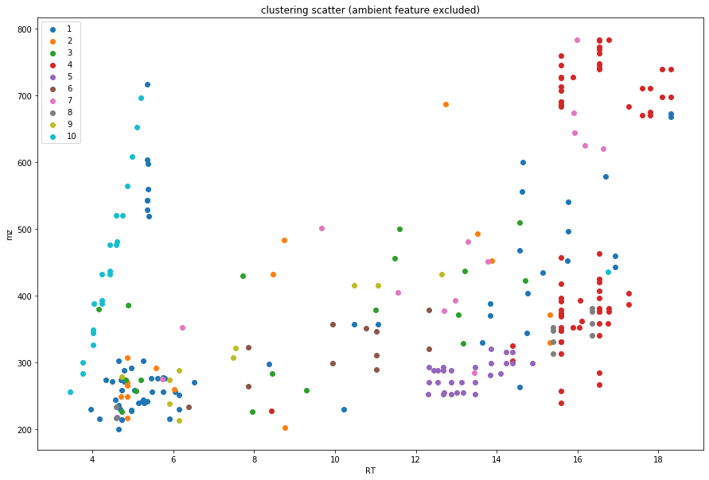
Data analysis based on machine learning algorithms
Feature clustering based on scikit-learn algorithms or hypothesis testing
Advanced modeling on dilution series samples
Preliminary source tracking tool

Slide 18
Modeling options for user
General function
Rf/lasso/other
Linear regression
Use cluster
Use cluster
Use all features
Use all features
Ensemble method
Separate model information & report
Separate model information & report
Performance report
Performance report
Performance report
Merged model
Merged model

Slide 19
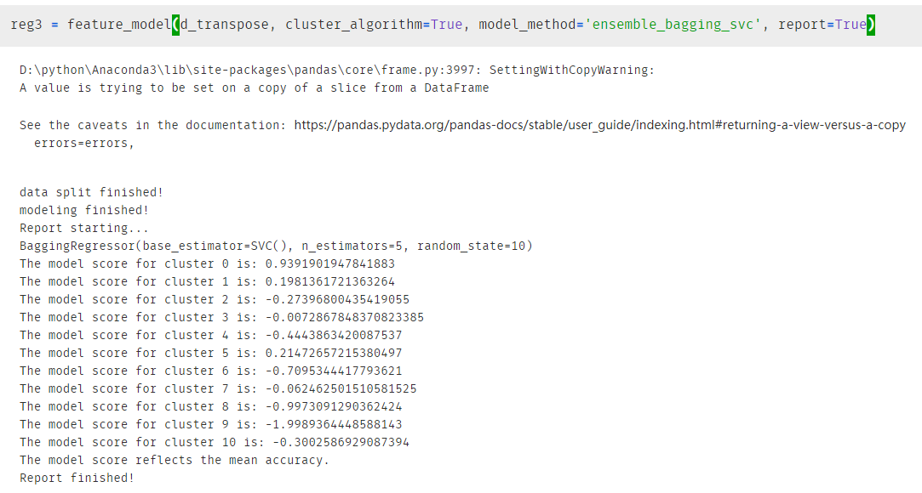
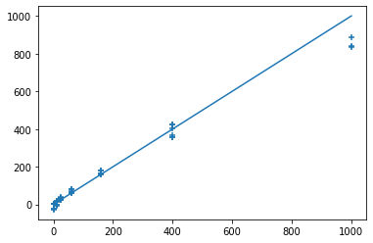
Modeling output
Based on the cluster information and model score, user can pick individual clusters for prediction.

Slide 20
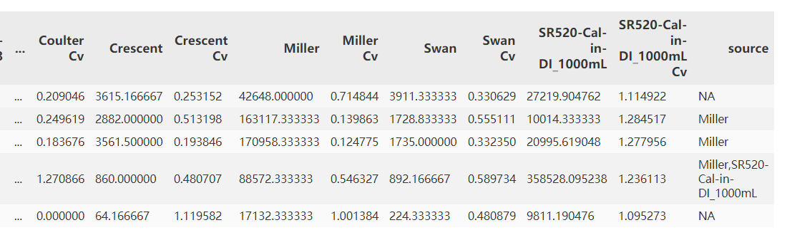
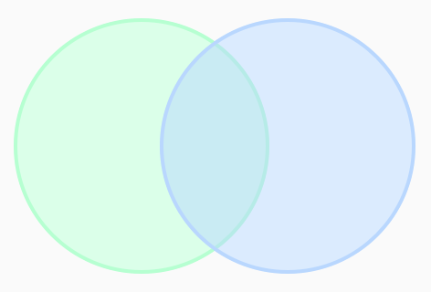
Quick source ID based on Venn diagram idea
Providing a quick & easy way to track sources
Possible to utilize the cluster information to improve the source tracking process
More detailed report
noise
Source1
(area > thres)
Source
1 & 2
Source2
(area > thres)

Slide 21
Data visualization
Interactive plot for HRMS data visualization
Online database searching
Realtime database matching and searching using selected database
More we can do

Slide 22
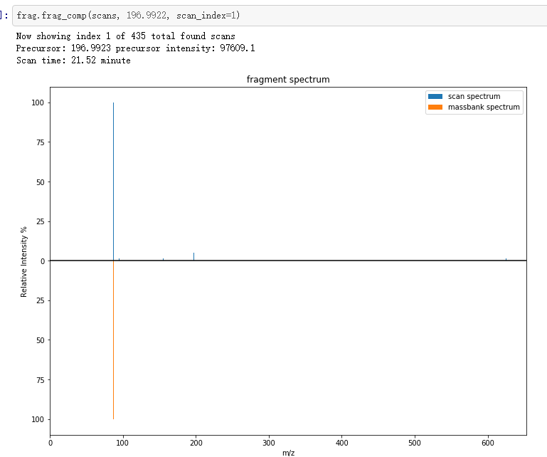
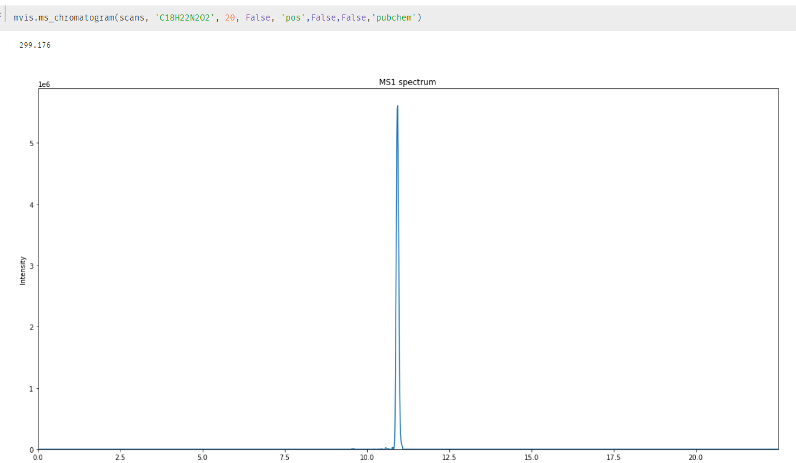
Molecular fragment comparison/search
via online database
Chromatogram for selected precursor

Slide 23
Why mass-suite

Slide 24
Pros
General:
First package on python which provide full workflow from data import to alignment result
Light memory usage make it possible to be run on personal laptops
Remote process option
Modularized setup – always possible for more
Open source – free to go!
Peak picking
Pymzml import enables faster speed
Peak score to enhance data quality
Alignment
Can do the alignment for 100+ files in ~10 min
Flexible settings for users
Data analysis
Visualization result for assess the analysis quality
Open end algorithm options to fit different needs
Handy function to boost up efficiency

Slide 25
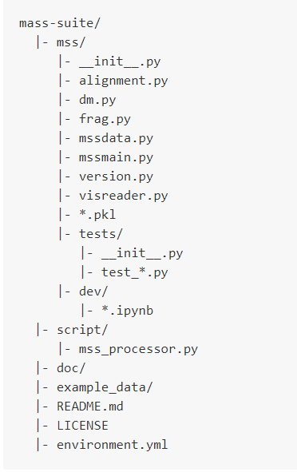
Documentation & Testing
Major documentation is now in the README of the repository
Travis CI is incorporated to make sure the package pass through without hitch

Slide 26
Future development & update
Validation of the workflow using more data
Understand chemical commonality behind clusters
GUI/webtool on visualization and for non-programmer users
Dynamically update according to needs

Slide 27
Related information
Installation:
https://pypi.org/project/mass-suite/
Github page & documentation:
https://github.com/XiminHu/mass-suite
Contact:
xhu66@uw.edu

Slide 28
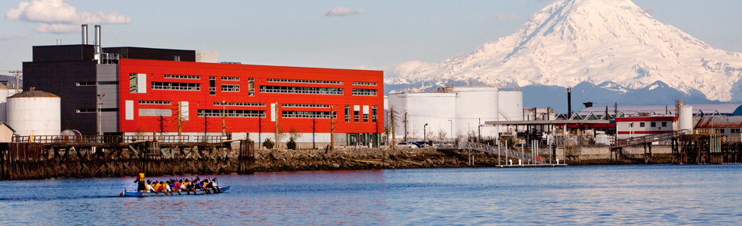

Acknowledgement:
A big shout to Professor Edward Kolodziej, Professor Dave Beck, Dr. Katherine Peter, and the Center of Urban Water for all their help during the development of this package.

Slide 29
Thanks!

